Slide 1
Prediction Model For Customer Satisfaction For Restaurants Business Development & Revenue
Under the Guidance of
Mrs. Uma M (Asst Prof.(Sr.G))
1201310056 Mohit Ratnesh
1201310057 Sourabh Agarwal

Slide 2
Abstract
Customer Satisfaction is the main objective of any business to grow and develop in any positive way. Customer satisfaction is not the easy thing to achieve, it requires a lot of hard work and prediction to reach the ultimate decision that will make customer happy. In the era of technology, the customers are more complex and requires more services to satisfy them. Manual prediction are more intense that is not possible for single minds to keep track off. Therefore this application is created in such manner that it will help the business owners to predict the requirements of the customer and meet their demands. To do we have collected different data sets and feedback from different restaurant websites. To develop the business revenue, we have identified the two kind of customers (happy & sad) from the dataset and providing different level of offers according to customers. Hence it increases business development. J48 classifier used to increase the accuracy of prediction of the customer retention for restaurants.

Slide 3
Problem Description
Problem description is the way of addressing the issues and views which lead to the creation of this project. The problem for this project was to find the way to increase the business development for the restaurants by identifying the key parameters of customer’s preferences and ultimately predict whether customer will comeback or not. The five w’s (who, what, Where, when and why) is the main key to define the problem. For this project we can define them as :-
1. Who :This project problem is specifically addressed to the restaurants and restaurants based organisations.
2. What :This project problem is mainly Focused to increase the business development of the restaurants therefore it can only determine the customer related issues that affects the organisation not the internal issues of organisation till date.
3. When :This problem can occur many times at restaurant when people don’t come often therefore this can be used at this times to address the problems and attracts customers.

Slide 4
4. Where :This kind of problem occurs in small scale restaurants organisations which does not have much resources to counter the continuous market growth therefore this project can help them by investing very small amount of resources.
5. Why :This problem will help all the restaurant organisations to increase the productivity also it will help the customers to distinguish their restaurants more easily as it will try to provide all type of support possible to keep customer happy.
In the end we can say this problem solution can lead a large group of successful restaurant organisation and also will provide satisfaction to many customers and people related to the organisations.

Slide 5
Existing Technologies
Innkey Restaurant POS
InnkeyPOS is the complete restaurant management system which covers total needs of your business lifecycle. It will act as your restaurant billing software and cover entire business operations like restaurant billing, sales, stocks, cost control, payroll and finance.
True Restaurant Management
True Restaurant is easy to use, full of the features a Bar uses many time, every day, and is very affordable price. True Restaurant Management software should have made order entry easier, make customers happier build a restaurant and Bar business.

Slide 6
Proposed Methodology
We will be delivering a product which will not only do the basic operations but will take customers reviews and feedback and also predict whether the customer is satisfied or not.
The product will help the Admin to plan their investment strategies as their will be wide range of data provided which will help them to analyze and plan.
The product is not limited to the certain level of organizations , it can be used by many different types of restaurants to improve their business strategies and increase their business revenue by analyzing the rate of customer satisfaction.

Slide 7
Algorithm
J48 or Decision Tree
It builds decision trees from a set of training data by using the concept of information entropy. The training data is a set of already classified samples. Each sample consists of a p-dimensional vector, where it represent attribute values or features of the sample, as well as the class in which it falls.
At each node of the tree, it chooses the attribute of the data that most effectively splits its set of samples into subsets enriched in one class or the other. The splitting criterion is the normalized information gain (difference in entropy). The attribute with the highest normalized information gain is chosen to make the decision. The C4.5 algorithm then recurs on the smaller sub-lists.

Slide 8
Requirements
1. Functional Requirement
The Functional requirement for this application is to acquire the feedbacks from customer.
The Functional requirement for this application is to predict the customer’s visit to restaurants.
The functional requirement for this application is to generate offers for customer on the basis of their feedbacks.

Slide 9
The Functional requirement for this application is to generate the view of most valuable user and their food selections.
The Functional requirement for this application is to generate the view of most ordered food items to manage productivity.
The Functional requirement for this application is to generate the view of priced related feedbacks.

Slide 10
The Functional requirement for this application is to generate the view of parking related feedbacks.
The Functional requirement for this application is to generate the offer code for the registered customers.
The Functional requirement for this application is to verify the offer code on next visit of customer’s.

Slide 11
2. Non-Functional Requirements
I. Performance Requirement
The application should take minimum response time for any action.
The application should take minimum response time to load UI for the application.
The application should be connected to offline server during the restaurants working hours.

Slide 12
II. Safety & Security Requirement
The application must have a login Id and password for all their registered users.
The application database can only be modified with the developers or in presence of the developer.
The application will use a unique Id to keep track of its customer’s.

Slide 13
III. Software Quality Attribute
The application will provide the capability to keep backup for the data if required.
System shall keep track of all errors as Log file.
The application will be reliable to continuous feedbacks and logins.

Slide 14
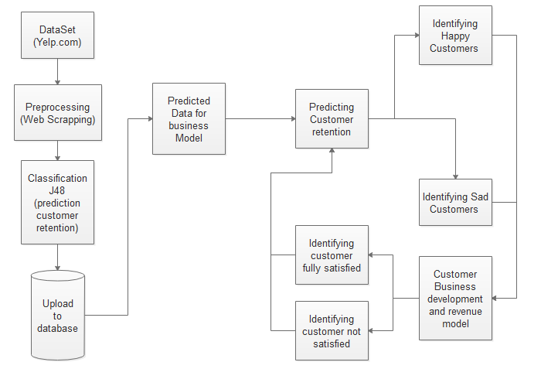
System Architecture
Fig: System Architecture for the customer satisfaction model

Slide 15
Module Description
Data Collection
For data collection we extracted the data for different restaurants and factors from the yelp.com website. The data collected from the website had many features like fooding, services, clothing, customer nature, location, topology, rating, reviews, etc. The data was extracted using python with beautiful soup as a package. The data was in raw and unordered format which was stored in csv format which can be used in business revenue model.
Feature Extraction
The data collected from the collection phase was in raw nature and contained the information which was not needed for the prediction model. This features like topololgy, location was not necessary and was needed to be preprocessed which was done by the python using pandas as package and also inbuilt weka tool preprocessor to exactly create the data needed for the prediction model.

Slide 16
Classification
We used J48 Classifier which is defined in WEKA Tool to predict and test the efficiency of the trained data set. J-48 classifier had more accuracy and efficiency in both training set and cross validation. It builds decision trees from a set of training data by using the concept of information entropy. The training data is a set of already classified samples. Each sample consists of a p-dimensional vector, where it represent attribute values or features of the sample, as well as the class in which it falls. The J-48 classifier was used because it provided 99% accuracy when compared to other algorithms mentioned in reference.

Slide 17
Prediction Model
Prediction model of our project predicts whether the customer will come again or not. To do so we created a trained data with the help of historical data gathered from websites the tested the train data to predict customer will come back again or not.
Business Development Model
In business model we created an offline platform for the organization and combined with the prediction model to predict whether the customer will come again or not. To do so we used web technologies like Jsp, Html and other web technologies. The model can provide offers to customers on the basis of their reviews to help the organization to attract more customers. Also this model can continuously monitor the customers and hence provide the offers provided by the organization

Slide 18
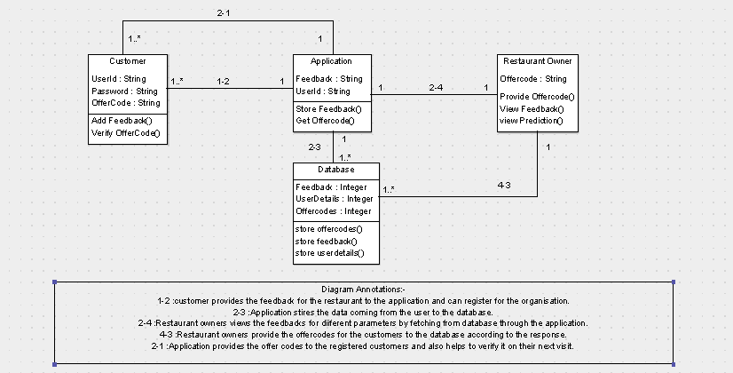
Project View & Design
Fig : Class Diagram For Customer Satisfaction Model

Slide 19
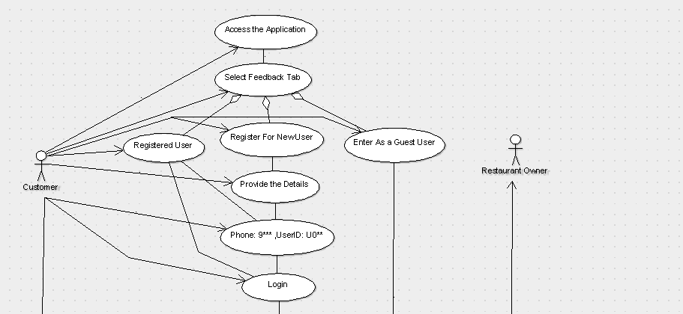
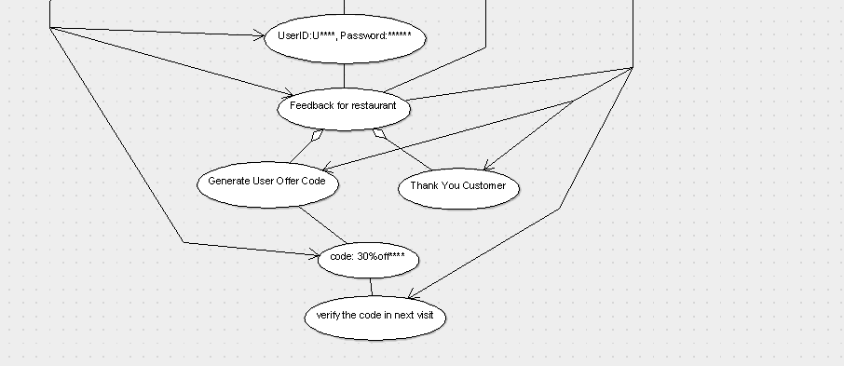
Fig : Use Case Diagram for Customer Satisfaction Model

Slide 20
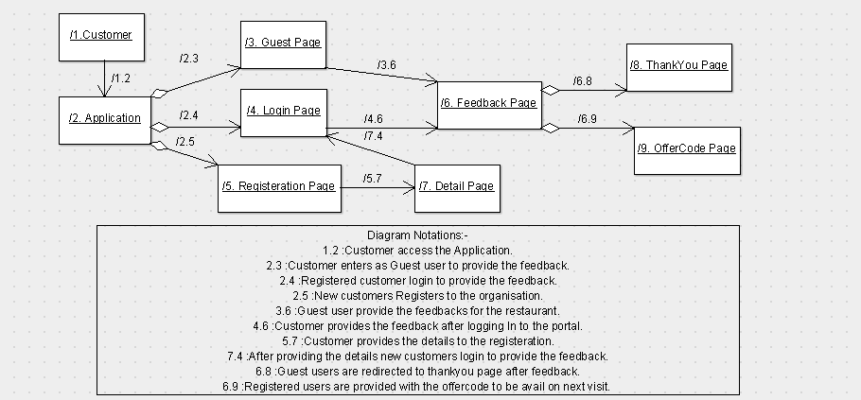
Fig : Collaboration Diagram for Customers

Slide 21
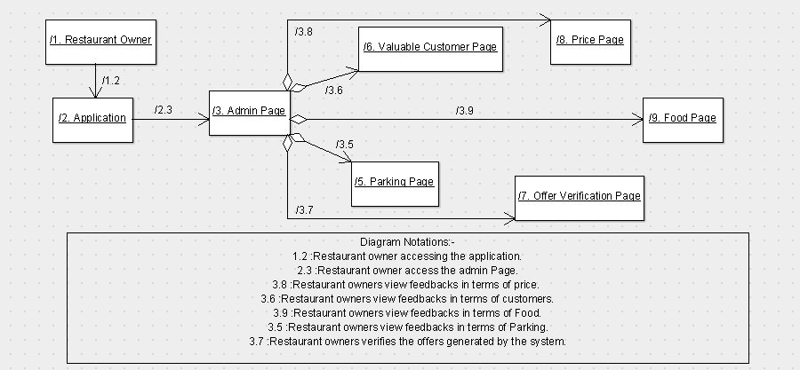
Fig : Collaboration Diagram for Restaurant owners

Slide 22
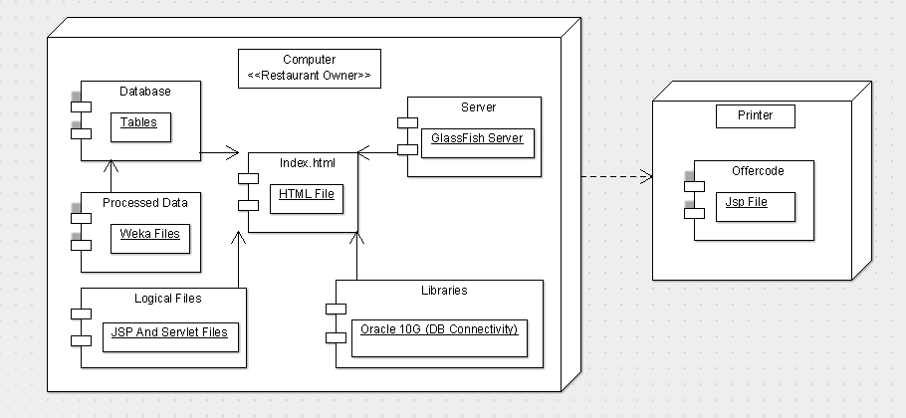
Fig : Deployment Diagram For Customer Satisfaction Model

Slide 23
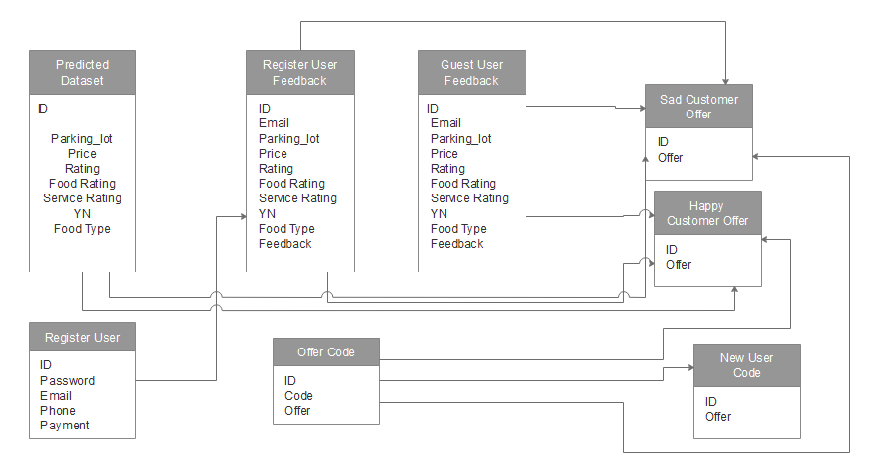
Fig: Relational Diagram For Customer Satisfaction Model

Slide 24
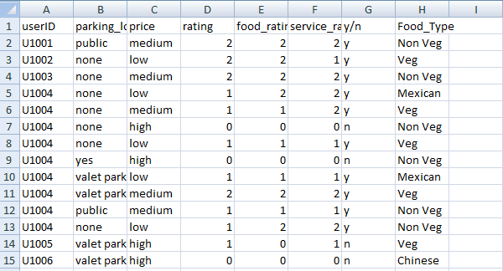
Project Demo
Prediction output.
Fig: Trained Data Set for Prediction Model

Slide 25
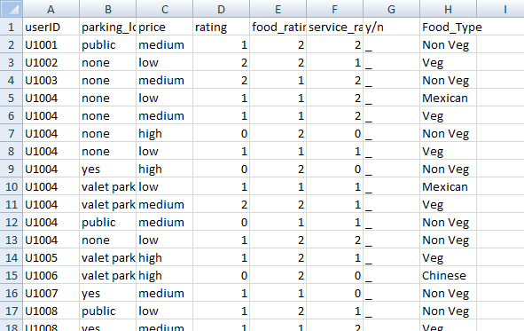
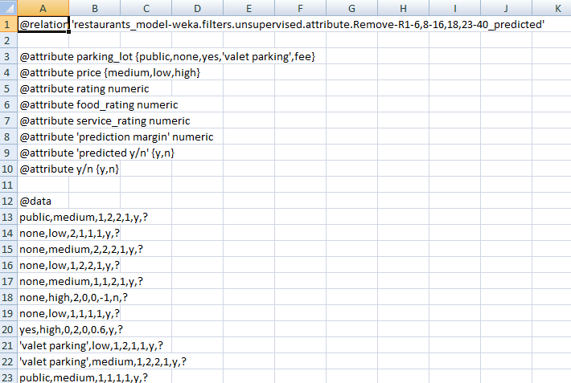
Fig : Test Data Set for prediction model
Fig: Predicted Output for prediction model

Slide 26
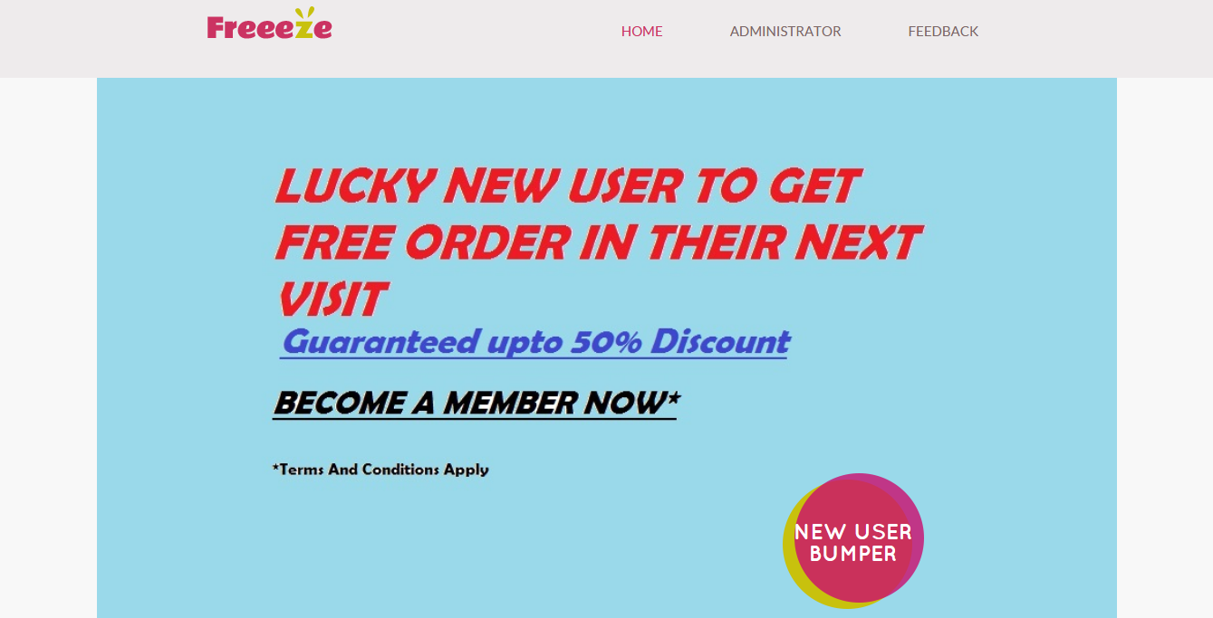
Fig: Home page

Slide 27
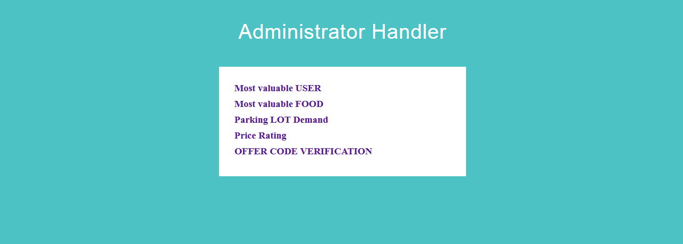
Fig : Administrator Page

Slide 28
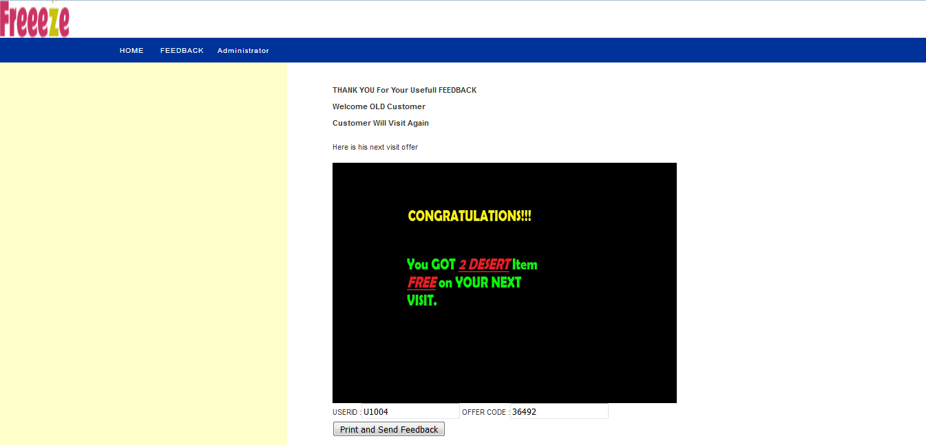
Fig : Prediction Page

Slide 29
Unit Testing
Unit testing is a level of software testing where individual units of a software are tested. The purpose is to validate that each unit of the software performed as designed.

Slide 30
Unit Testing Test Cases
Test ID | Test Case | Procedure | Input | Expected output | Output | Remarks
UT101-UT110 | Unit Testing For Homepage to check title and css element | Open homepage Add Command to check title Add command to check css file | Open Verify Title Assert Element | No Error | No Error | Passed
UT111-UT113 | Unit Testing For Login Page To check inputs and elements. | Open homepage Click feedback page Enter credentials Click login | Open Click & wait Click & wait Type Click & wait | No Error (user details) | No Error (user details) | passed
UT114-UT116 | Unit Testing For Login Page To check inputs and elements. | Open homepage Click feedback page Enter credentials Click login | Open Click & wait Click & wait Type Click & wait | No Error | Error (internal server error) | Failed

Slide 31
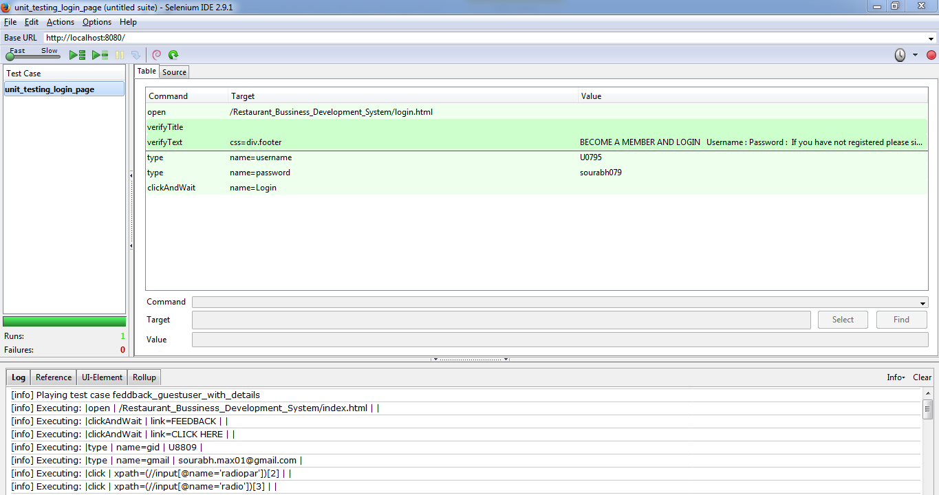
Fig : Unit Testing For Login Page

Slide 32
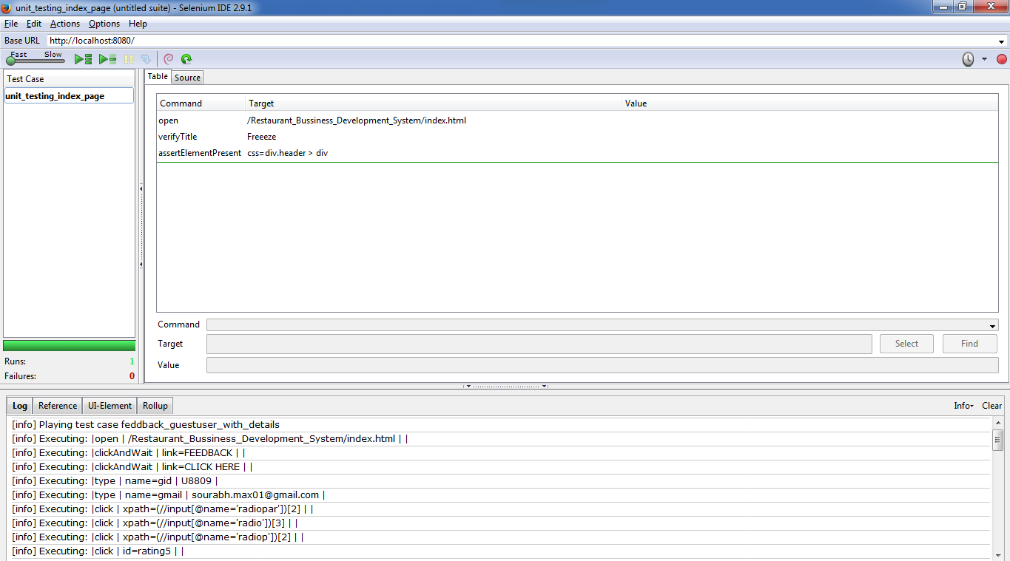
Fig : Unit Testing For the Home Page

Slide 33
Integration Testing
Integration testing is the testing done between the individuals modules to test whether they are compatible to each other or integrate with each other.

Slide 34
Test case for Integration Testing
Test ID | Test Case | Procedure | Input | Expected output | Output | Remarks
T101-T110 | Integration Testing from homepage to admin page to valuable user page | Open homepage Click admin page Click valuable user | Open Click & wait Click & wait | No Error | No Error | Passed
T111-T113 | Integration Testing from homepage to Admin Page to most valuable user page to search particular user | Open homepage Click admin page Click valuable user Click select user Enter userId Click search | Open Click & wait Click & wait Click & wait Type Click & wait | No Error (user details) | No Error (user details) | passed
T114-T116 | Integration Testing from homepage to Admin Page to most valuable user page to search particular user | Open homepage Click admin page Click valuable user Click select user Enter userId Click search | Open Click & wait Click & wait Click & wait Type Click & wait | No Error (user details) | Error (internal server error) | Failed

Slide 35
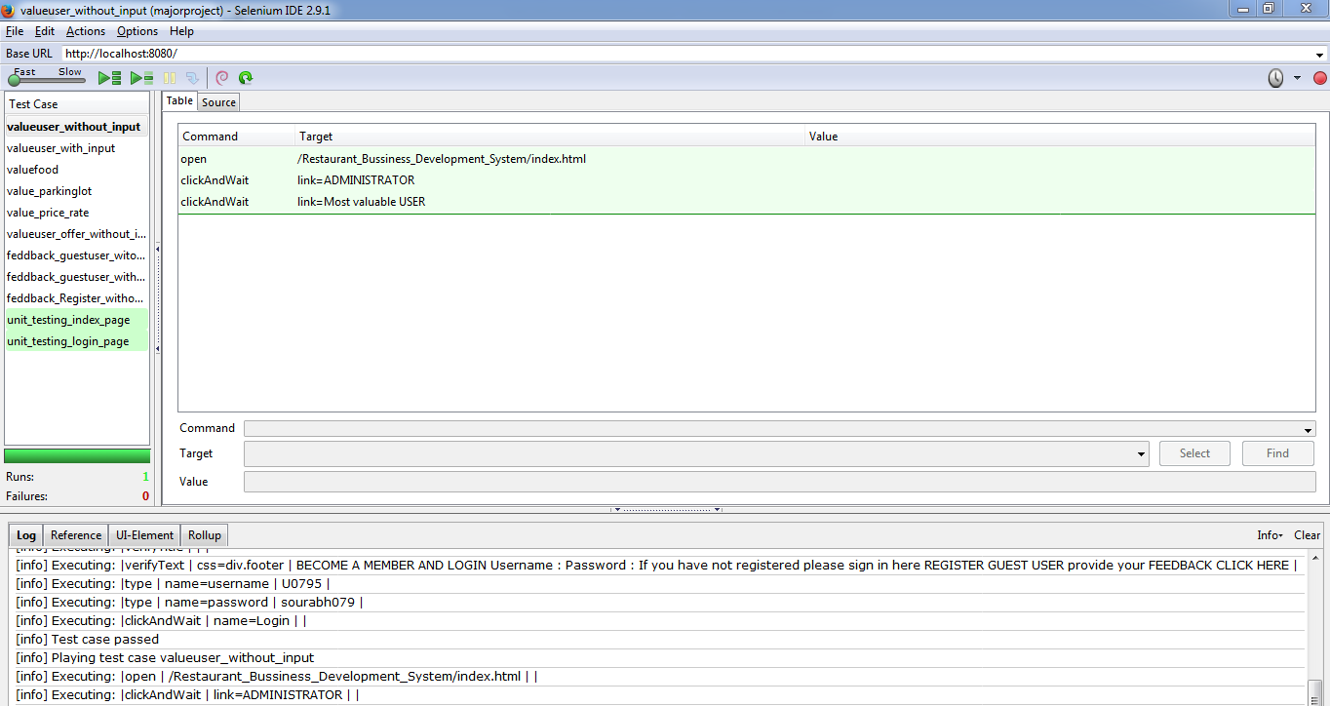
Integration Testing Output
Fig: Integration Testing TC101

Slide 36
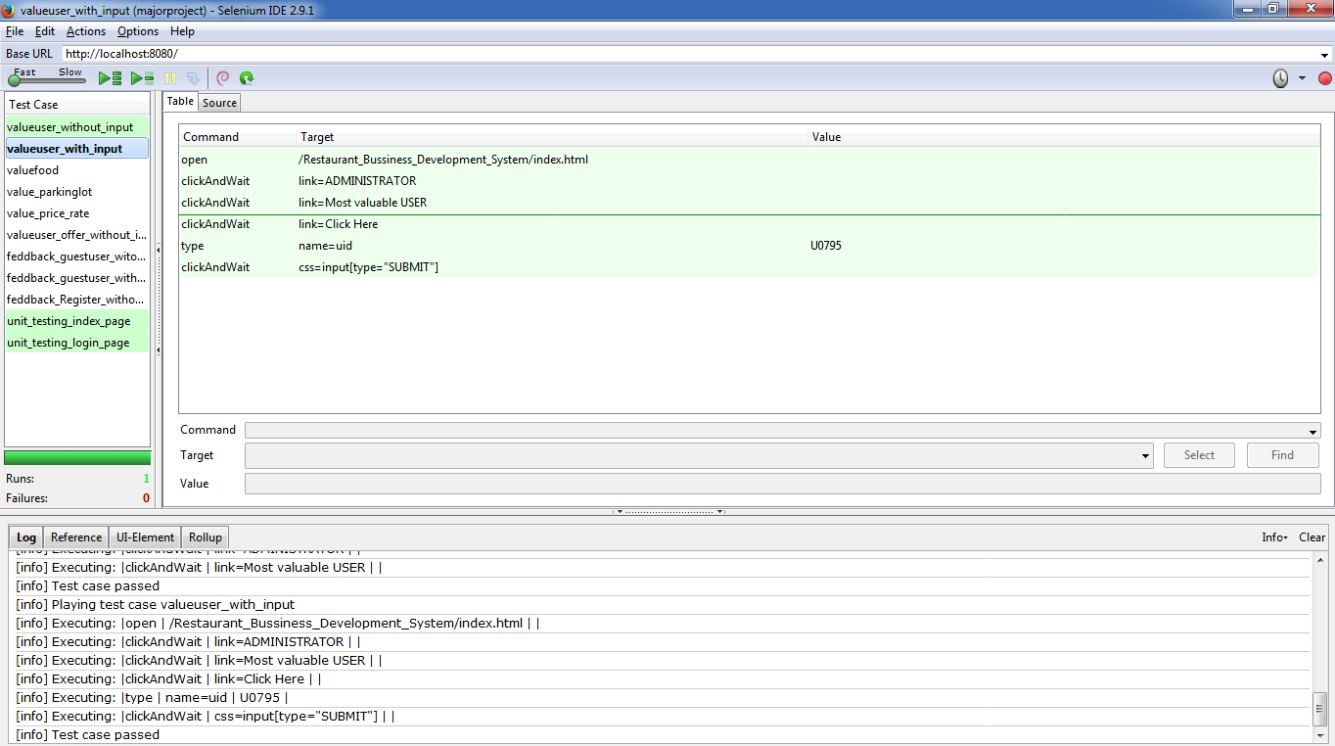
Integration Testing Output
Fig :Integration Testing TC 111-113

Slide 37
User Testing
User testing or Acceptance testing is the testing done to test the software interaction and working with real time scenario and environment.

Slide 38
User Testing TestCase
Test Id | User | Acceptance Requirement | Critical |  | Test Result |  | Comment
 |  |  | Yes | No | Accept | Reject
UT001 | Student | The application should work till End |  |  |  |  | Application predicted but UI can be Good.
UT002 | Student | The application should verify the offer code |  |  |  |  | Application verified the offer code satisfied.
UT003 | Student | Application should display data wrt, different features |  |  |  |  | Detail description should be better.

Slide 39
User Report
Report Identifier | Sourabh Agarwal
Summary | To satisfy maximum users with the application working and prediction.
Variances | Application may experience server errors due to listener problem causing inconsistency in performance of application.
Summary of Results | Maximum users are satisfied with the application and its prediction for the customers.
Evaluation | Many users rated it a ‘B’ level software in terms of its working and prediction.
Recommendations | Many users recommended to modify the GUI of the application and increase the detailing of attributes to admin section.
Summary of Activities | Many user find moving across the application is user friendly and is more convenient and flexible in terms of providing feedback.
Approval | Many users approved the application.
Table : User Testing Report

Slide 40
Size –LOC (lines of codes)
The Estimate lines of code was 2000.
The new estimated value for line of code came to be 2090 using sonar qube.
The sonar qube does not analyse the html, css and Jsp files.
Therefore including the Html and Jsp files the lines of code reached to 5200

Slide 41
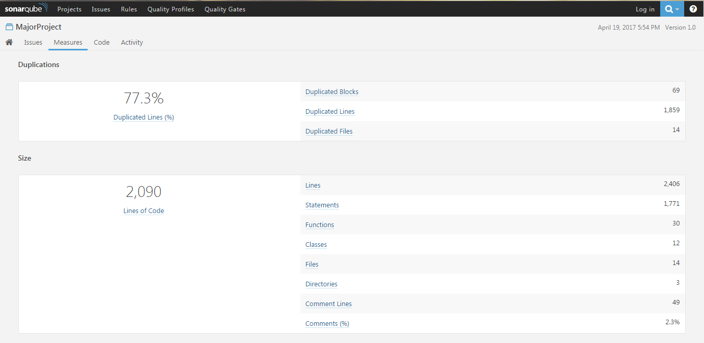
LOC Output
Fig: Lines of code by sonarqube

Slide 42
Risk Analysis
Risk assessment Questionaries’ :-
1- Have top software and customer managers formally committed to support the project?
Yes
2- Are end users enthusiastically committed to the project and the system to be built?
Yes
3- Are requirements fully understood by the software engineering team and its customers?
Yes
4- Have customers been involved fully in the definition of requirements?
No
5- Do end users have realistic expectations?
Yes

Slide 43
6- Is the project scope stable?
Yes
7- Does the software engineering team have the right mix of skills?
Yes
8- Are project requirements stable?
No
9- Does the project team have experience with the technology to be implemented?
No
10- Is the number of people on the project team adequate to the job?
Yes
11- Do all users constituencies agree on the importance of the project and on the requirements for the system to be built?
Yes

Slide 44
Risk Information Sheet
Risk Id: RI001 | Date: 8/2/2017 | Prob: 80% | Impact: high
Description: The Risk of listener problem for the oracle database may occur much more often during execution which may lead to crashing of the application to fetch data.
Refinement/context: The listener problem can occur due to the sudden shutting down tof the services that is being provided by operating system which may occur due to some kind of load/stressing problems.
Mitigation/Monitoring: it is been noticed that this problem might occur after 17 attempts of the database service calling which lead to termination of database link between the application. It is advised that in case of problem restart the oracle services to refresh the link.
Management/contingency/trigger: This kind of problem can be triggered due to calling of the service many times in a row which causes the load on the database services to handle the request for the application.
Current Status: The chances of this problem occurring is reduced to 40-30% and may or may not occur in many of the systems.
Originator: Sourabh Agarwal |  | Assigned: -
Table: Risk Analysis Report

Slide 45
Defect Analysis
It is the process of handling the defects found during the different phases of the testing.
The defect report is a report with complete defect description and handling of the description.

Slide 46
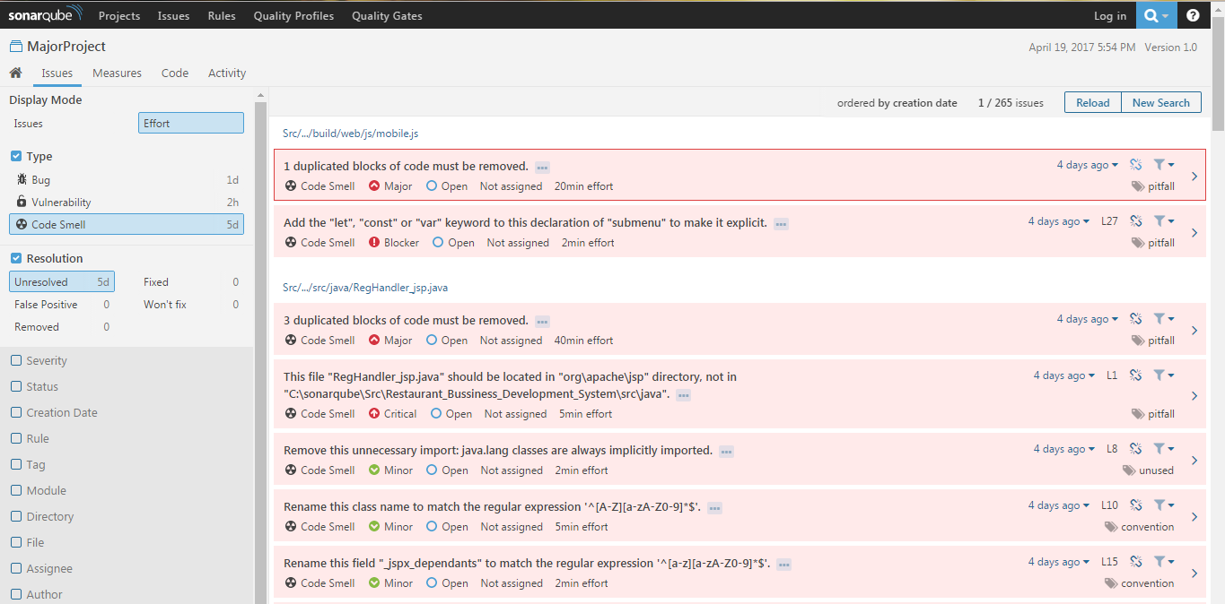
Fig : Defects reported by sonar qube for the customer satisfaction model

Slide 47
Defect Report
Defect Report
ID | DT001
Project Name | Major Project
Product Name | Restaurant business development system (RBDS)
Release Version | 1.0
Module | DB Connectivity
Detect Build Version | 1.0
Summary | Oracle 10G jar file unstable for connection
Description | After Sometimes of execution the link to database terminates which causes unexpected error to application
Steps to replicate | Add Oracle 10G Jar file to the libraries of application. Clean and Build the Project. Run the Application N no of time till the connection breaks. Error occurs.
Actual Result | Internal Server error (Listener refuses problem)
Expected Result | Internal Server error (Listener refuses problem)
Attachment | -
Remarks | Execution failed
Defect Severity | High
Defect Priority | Primary
Reported By | Sourabh Agarwal
Assigned to | -
Status | pending
Fixed Build Version | Yet to release
Table : Defect report for DT001

Slide 48
Fishbone Diagram for Defect
Defect
Database
Servlet file
Directory
Connectivity file
Performance
Ram
Cpu Performance

Slide 49
Mc Call’s Quality Factor
Mc Calls’s Quality factor has 11 quality factors which helps in determining the quality of a software.

Slide 50
Mc Calls’s Quality Factor
MC Call’s Quality Factor
Correctness | The application has the correctness property as it predicts the customers visit for every feedback.
Reliability | The application is reliable and performs maximum functionality with correct precision.
Efficiency | The application is not Efficient for poorly configured system. But it can be efficient if directly executed in server.
Integrity | The application provides integrity to maximum extent by providing logging option on both ends. Still is vulnerable to hacking like (sql injection,etc).
Usability | The usability factor for the application is optimum and can easily operated and is user friendly.
Maintainability | The Application is highly maintainable as it requires updation of predicted datasets with certain interval of times.
Testability | The application is highly testable due to its modularity and mostly being a web application.
Flexibility | The flexibility of the application is optimum as it requires good knowledge of the code before making changes.
Portability | The application is highly portable because of being web application and can run in many browsers.
Reusability | The application is highly reusable of being distinguished modules which can be also used in different application.
Interoperability | The application is highly interoperable due to web application it can easily connect to different modules through links and other systems.
Table : Mc Call’s Quality Factor for RBDS

Slide 51
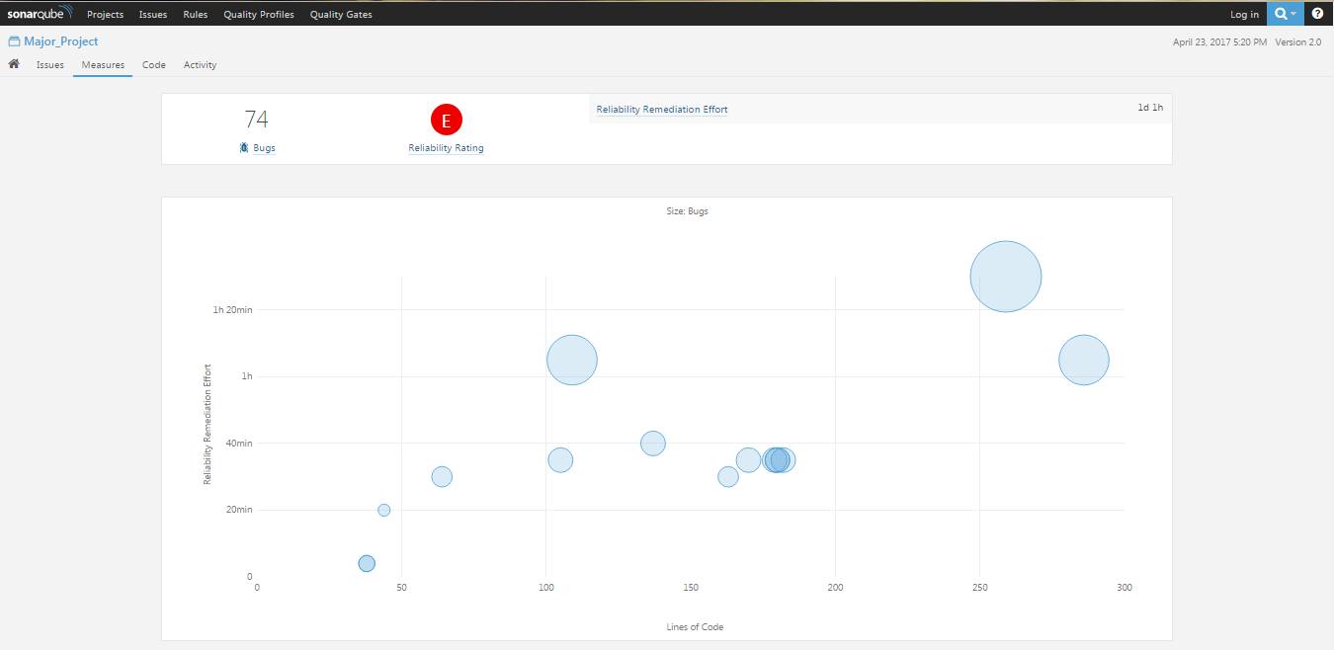
Mc Call’s Factors Output
Fig : Reliability Rating and Graph

Slide 52
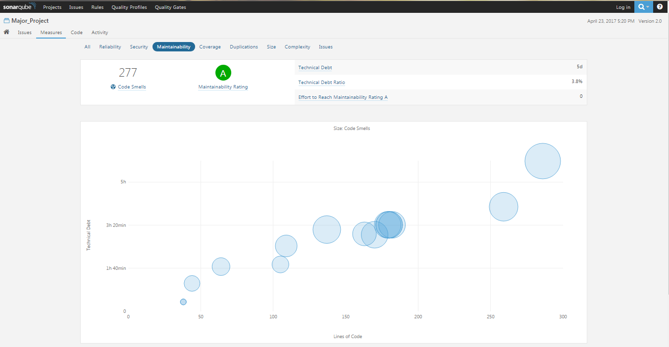
Mc Call’s Factor Output
Fig : Maintainability Rating and Graph

Slide 53
Result
The Application can successfully predict the customers visit.
The Application can successfully provide the offers to customers on the basis of feedback.
The owner can keep track of the resources that will help him to keep customer happy.

Slide 54
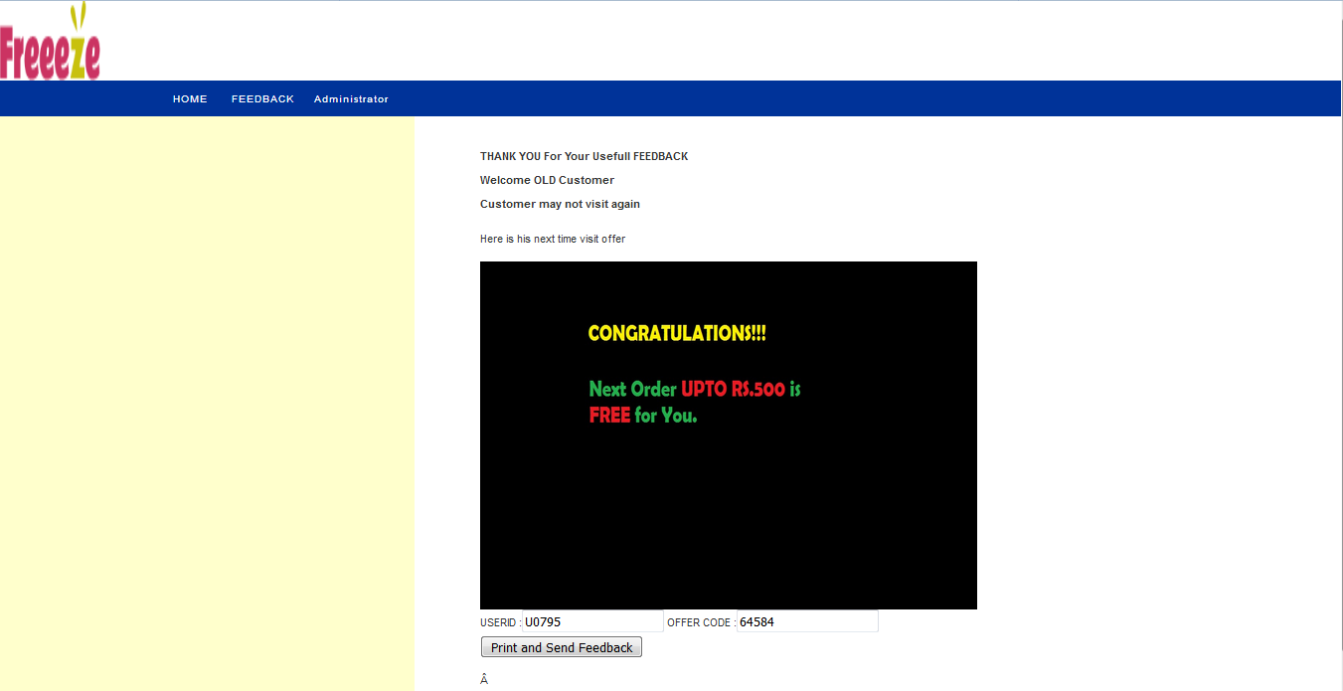
Result Output
Fig : Customer Predicting screen

Slide 55
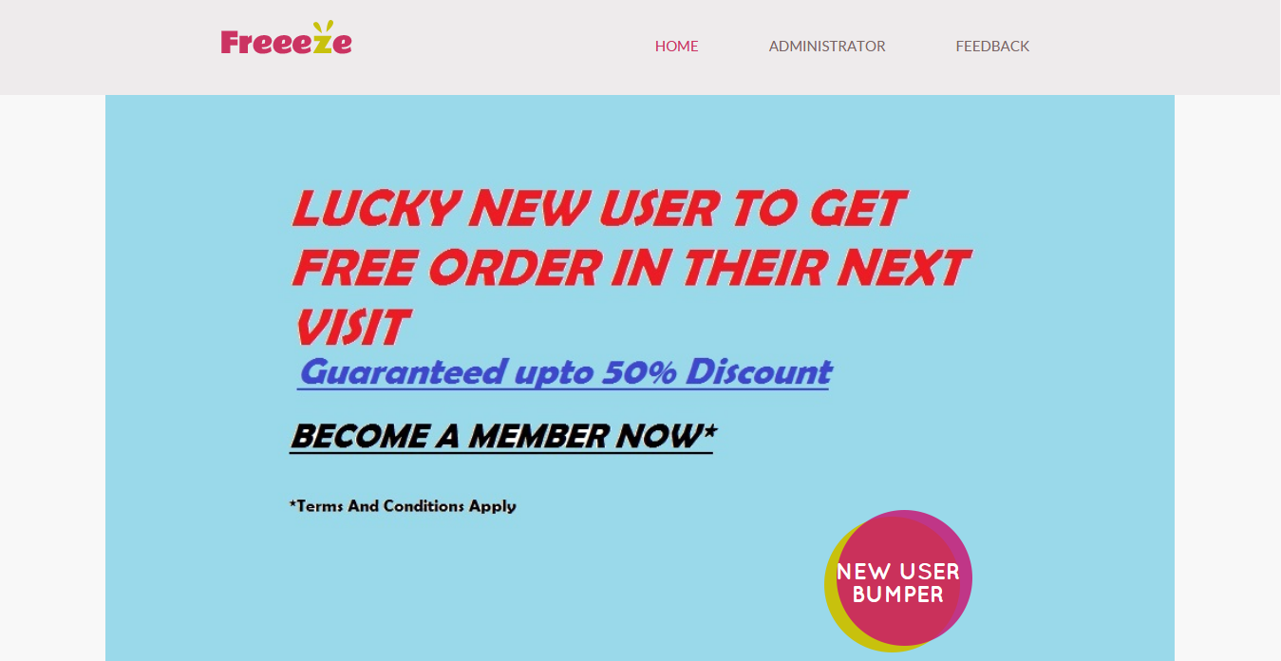
Result Output
Fig : Homepage of application

Slide 56
Result Analysis
Result analysis is done to compare the results that we have achieved is the only result or better results can be achieved.
The J48 or decision tree algorithm was selected because it had the 99.2308% correction value while in comparison to decision table algorithm which was used in referred journal it only produced 97.6923% correction value which ultimately leads us to the selection of J48 algorithm.

Slide 57
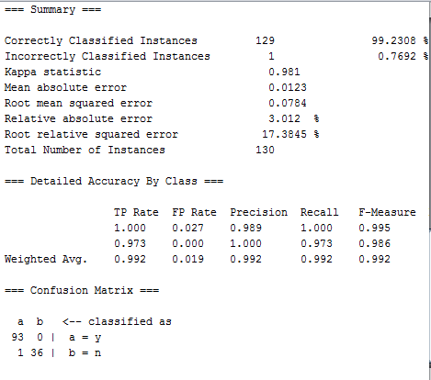
Result Analysis
Fig : Results of J48 Algorithm

Slide 58
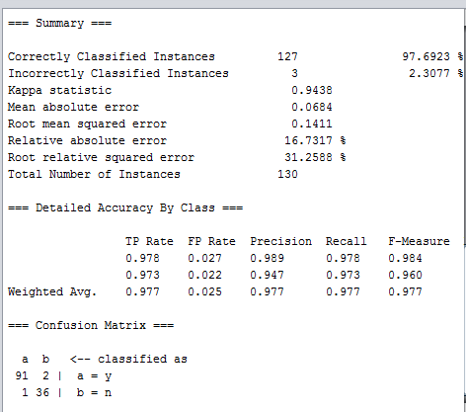
Result Analysis
Fig : Result of Decision table Algorithm

Slide 59
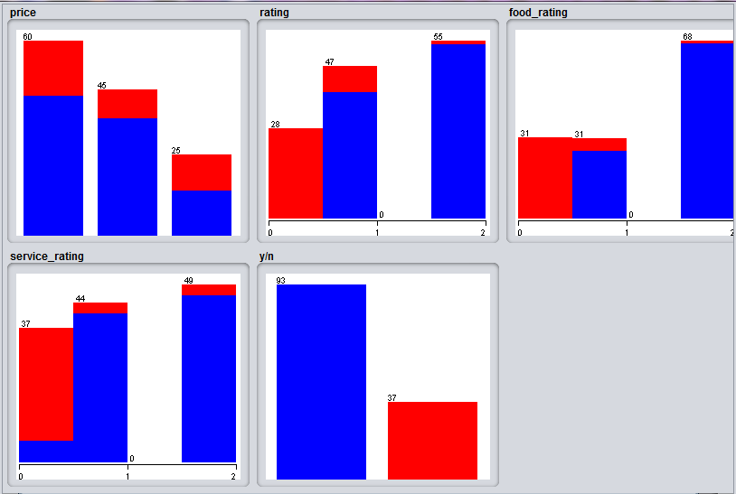
Result Analysis
Fig : J48 Classification algorithm statistics

Slide 60
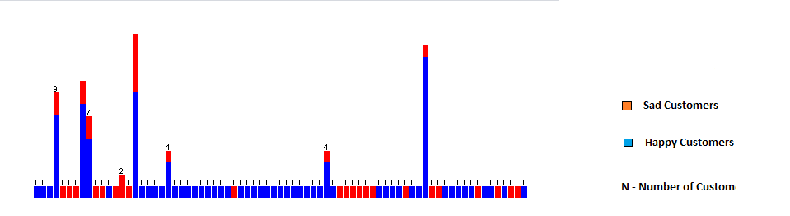
Fig : Customer Satisfaction Result For Prediction Model

Slide 61
Conclusion & Future Work
In The End we were able to develop a software which can help restaurant organizations and customers also. This application can also encourage to develop similar kind of software for various organization also.
In Future the customers can come to restaurants and can access the application through remote device and order food without any assist or can customize their order to save time.

Slide 62
Conclusion & Future Work
In Future organization can introduce swipe cards or RFID card to recharge their card and avail offers through it.
In Future organization or development team can make this product online by providing OTP instead of password.

